Slide 2
Andalusia Delegation visit to NECSTouR Brussels
24th of April, 2017
Person of Contact on Membership:
Mr Tomaso Comazzi tomaso.comazzi@necstour.eu Phone : +32 (0) 2 721 7293 Mobile: +32 (0) 4 98 10 89 67 www.necstour.eu

Slide 3
Agenda for the Meeting 15:00 – 16:00
15:00 – 15:10 Presentation of the Participants
15:10 – 15:30 Presentation of Alpujarras Commonwealth
15:30 – 15:50 Presentation of NECSTouR
15:50 – 16:00 Conclusion of the meeting

Slide 4
Participants
Mancomunidad de las Alpujarras
Raúl Ruiz Álvarez: Vicepresidente Primero de la Mancomunidad de Municipios de la Alpujarra Granadina, Delegado de Turismo, Cultura, Desarrollo Económico, Deportes y Comunicación.
Manuel Escobosa Manzano: Alcalde de Nevada
Asunción Martínez Fernández: Alcaldesa de Válor
María del Carmen Pérez Perea: Alcaldesa de Bubión
José Javier Vázquez Martín: Alcalde de Pórtugos
Juan Antonio Palomino Molina: Alcalde de El Valle
Rafael Valero García: Técnico Turismo
Delegación de la Junta de Andalucía
Francisca Pleguezuelos, Delegada
Lucas J. Ruiz Díaz, Técnico
NECSTouR
Cristina Núñez, Coordinator
Alex Constantinescu, Trainee

Slide 5
NECSTouR Mission
The Next Tourism !
Launch 2007 – Creation: 2009
“Creating the right balance between the welfare of tourists and local population, the needs and uses of the natural and cultural environment and the development and competitiveness of a destinations and its businesses”
A network of European Regions, associated with representatives of the tourism enterprises, tourism associations and universities/ research institutes
- A self financed network

Slide 6
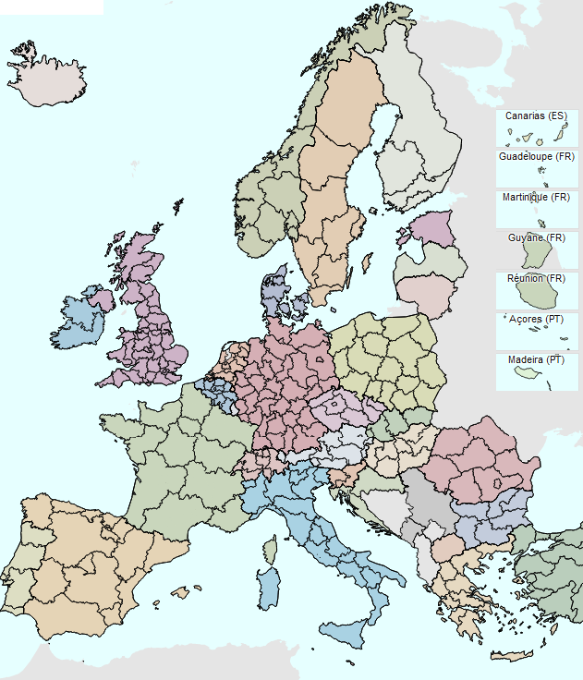
NECSTouR Members
FULL MEMBERS
33 Regional authorities (NUTS I, II and III)
Belgium: Flanders, German-speaking Community of Belgium Region, Wallonia
Bulgaria: Gabrovo
Croatia: Istria
Denmark: Central Denmark, Ringkøbing-Skjern
France: Brittany, Île-de-France, Occitanie,
Provence-Alpes-Côte d'Azur
Italy: Emilia Romagna, Lazio, Piedmont,
Puglia, Sardinia, Trentino, Tuscany, Veneto
The Netherlands: Limburg
Portugal: Alentejo, Algarve
Republic of Serbia: Vojvodina
Spain: Andalusia, Balearic Islands, Basque Country, Canary Islands, Catalonia, Galicia, Valencian Community
Sweden: Västra Götland
United Kingdom: Cornwall, Scotland

Slide 7
ACADEMIC MEMBERS
24 Representatives from the Academic Sector
Campus Foundation on Mediterranean Studies
CETT-UB
Business University in Administration and Enterprises of Tourism (ESCAET)
Ecolabel EMAS School of Tuscany
Fondacioni Europa
High Institute for Innovative Territorial Systems SiTi
Institute for Tourism Research in Northern Europe (NIT)
Institute of Agriculture and Tourism Poreč
Lapland University of Applied Sciences – Multidimensional Tourism Institute
Luspio University of Rome - Faculty of Economics
Observatory of Tourism Islands in Europe (OTIE)
National Council of Research – Biometereology Institute (CNR-IBIMET)
13. The Politechnical Insitute of Leiria
14. Responsible Tourism Institute
15. Technological Educational Institute of Epirus
16. University College of Business in Prague (VSO)
17. University of Applied Sciences of the Western Switzerland Valais - Institute of Tourism (HES-SO Valais-Wallis)
18. University of Bedfordshire – Institute for Truism Research (INTOUR)
19. University of Economics in Prague (VSE)
20. University of Florence
21. University of Girona
22. University of Malaga
23. University of Malta - Institute for Tourism, Travel & Culture
24. University of Pannonia/Presov

Slide 8
ASSOCIATED MEMBERS
9 National, European, International public/Private Organisation working in the Sustainable Tourism Sector
Croatian Chamber of Economy (HGK)
FederCultura Tourism Sport-Confcooperative
Forum of the Adriatic and Ionian Chambers of Commerce (FAICC)
French Chambers of Commerce and Industry Assembly (ACFCI)
Italian Association for Responsible Tourism (AITR)
Legacoop Tourism
Legambiente onlus
National Tourism Research Institute (ISNART)
Odyssea

Slide 9
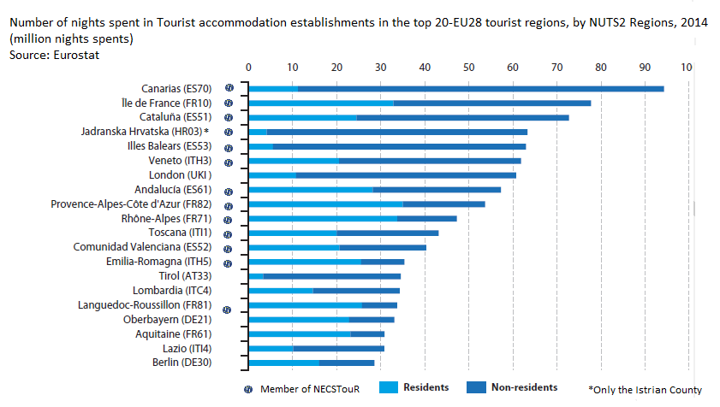
High Quality Members
We have the top Eu Touristic Regions

Slide 10
NECSTouR Governance
GENERAL ASSEMBLY
REGIONAL AUTHORITIES
Academic Committee
Associated Committee
EXECUTIVE COMMITTEE (3 Years)
President: Catalonia
Vice-President: Flanders
General Secretary: Tuscany
Treasurer: Västra Götaland
North: Cornwall, Limburg, Ile-de-France
East: Istria
South: PACA, Galicia, Andalucía, Veneto
PERMANENT SECRETARIAT (Brussels)

Slide 11
What about the Future of NECSTouR in the next 3 years (2016-2018)?
4 Working Groups
3 Strategies
4 Goals
1 Vision

Slide 12
STRATEGY
VISION
Build up a Touristic Europe based on S&C Tourism
Positioning NECSTouR model of Sustainable & Competitive Tourism
Raise the profile of Tourism in the EU agenda
Reinforce the role of Regions in the EU Tourism Policy
Mainstream of EU Funds for Tourism
GOALS
MEMBERSHIP
STRATEGIES
COMMUNICATION
STRATEGIC ALLIANCES
EXPERTISE

Slide 13
EUROPEAN COMMISSION
DG GROWTH
TOURISM, CULTURAL
& CREATIVE INDUSTRIES PRIORITIES
NECSTouR is focusing on the same
PRIORITIES through its Working Groups
Attracting Investment and Improvement Business conditions
Joint Promotion EU in Thirds Markets
Digital Revolution
Skills and Training

Slide 14
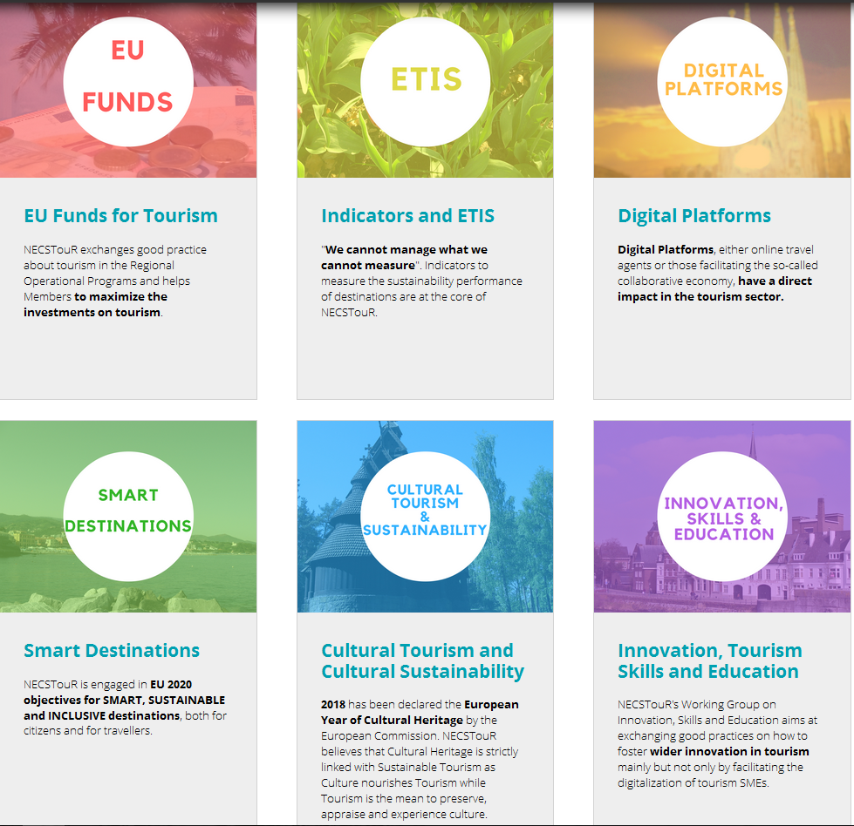

Slide 15
NECSTouR’s support to Alpujarras
Support the development and promotion of a more sustainable and competitive tourism: Good practices as well as cooperation with our Regions
Funding opportunities through projects: calls and partners
Strategic Alliances and contacts: European Parliament Intergroup, European Commission, UNWTO
https://www.youtube.com/watch?v=TcaATKBtcDA&feature=youtu.be&t=1m44s

Slide 16
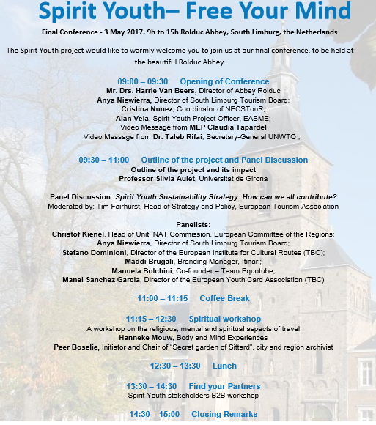
NECSTouR’s support to Alpujarras

Slide 17
Background information

Slide 18
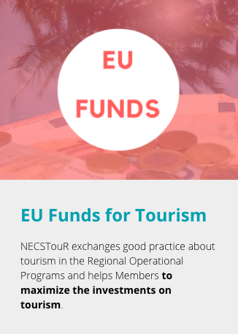
Best use of EU Funds to support the development of competitive and sustainable tourism in the EU
Monitor and analyze the development process of NECSTouR regions
Facilitate the exchange of expertise and good practices among regions
Develop the right policies to stimulate and support the development of responsible and sustainable tourism
The main highlights were discussed at the event on the 27th of September 2016, hosted at the European Committee of the Regions – the event will be continued this year on the same date

Slide 19
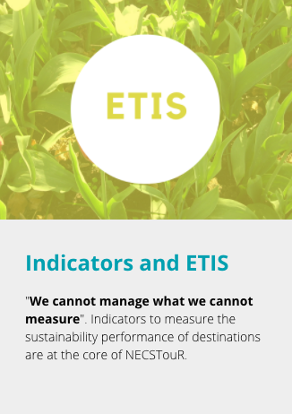
Support the development and implementation of sustainable tourism indicators to measure the destination’s performance at sub-national levels
The cooperation with official statistics bodies in order to gather the data by ensuring its accuracy, quality and comparability with similar destinations
Transform data provided by the indicators into further policies that support the development of a sustainable and competitive tourism

Slide 20
Identify, analyze and propose a balanced approach to address sharing economy in the tourism industry through legislation
Stimulate the cooperation among NECSTouR regions to discuss measures that aim at developing regulatory policies
Evaluation of the impacts of the proposed measures in our member regions
Organize further events in cooperation with EU Institutions in order to decide on the most appropriate policy tools to support the regions

Slide 21
Ensure that NECSTouR destinations are able to adapt and mitigate climate change effects by improving their sustainability practices
Exchange of regional strategies and research outcomes on innovation adaptation actions for regions tackling governance, products, training, marketing and SMEs competitiveness approach
Integration of the transversal economic/social/environmental nature of Tourism in EU policies, regulatory initiatives and financial instruments.
NECSTouR Thematic Conference on “Smart Tourism Destination’s Contribution for the Planet and its People” was organized together with UNWTO in frame of ‘ 2017 International Year for Sustainable Tourism Development’
An event on ‘Accessible Tourism’ will be held in June in Brussels together with Tuscany Region

Slide 22
Define a strategy to position tourism as a sector that supports the cultural identity of a community
Network with culture and creative industries stakeholders in order to foster cooperation among regions
Share experiences in measuring cultural tourism at sub-national level
Support the development of a common policy that manages resources in a sustainable way
NECSTouR regions are contributing to the definition of the main assets in the frame of ‘European Year of Cultural Heritage 2018’

Slide 23
Upgrade Tourism as a career of choice and to reduce the gaps between employees skills and enterprises needs
Exchange good practices among regions that stimulate the digitalization of tourism SMEs, partnership with academic institutions and businesses, specific training programs
Exchange good practices among regions on how destinations can innovate in order to follow market trends
Collaboration with the academic members in the development of skills and training to support sustainable and competitive tourism practices in the regions

Slide 24
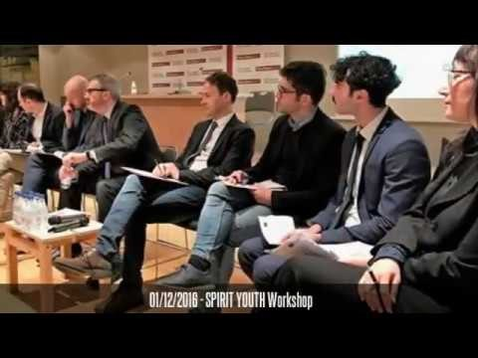
NECSTouR’s Activities and events
https://www.youtube.com/watch?v=aRSqaRe18jE

Slide 25
NECSTouR Projects (2)
NECSTouR Past Projects
NEZEH Nearly Zero Energy Hotels
Programme: Intelligent Energy Europe
Duration: April 2013 – April 2016
Objective To accelerate the rate of refurbishment of existing buildings into Nearly Zero Energy Buildings (NZEB), supporting the private sector and promoting the front runners.
MITOMED
Programme: MED
Duration: July 2014 – June 2015
Objective To promote an integrated management model of maritime and coastal (M&C) tourism in the Mediterranean by improving the quantity and quality of data, information, products, services and policies pertaining to the sector.
Mapping and Performance Check of the Supply Side
of Tourism Education and Training
Programme: CIP - Tender
Duration: August 2014 – October 2015
Objective: To examine the EU 28 education and training framework for tourism and to assess in providing the necessary labour market skills for employers.
NECSTouR Climate Change & Tourism TF
NECSTouR NIT TF & NECSTouR MED Regions
NECSTouR Academic Board and Associated Members

Slide 26
NECSTouR Ongoing Projects
Spirit Youth
Programme: COSME
Duration: 2016 – 2017
Objective: To investigate the spiritual tourism market with Europe.
NECSTouR Regions, Academics and Associated Members

Slide 27
NECSTouR Ongoing Projects
MITOMED +
Programme: MED
Duration: 2017-2019
Objective Protecting and promoting Mediterranean natural and cultural resources Programme specific objective: To enhance sustainable the development policies for more efficient valorisation of natural resources and cultural heritage in coastal and adjacent maritime areasof a sustainable and responsible coastal and maritime tourism in the MED Area.
NECSTouR Regions, Academics and Associated Members

Slide 28
NECSTouR Cooperation
European Tourism Networks ing Group: ERDN, FARNET, EDEN, European Travel Commission, EEN and ERRIN
ENAT – European Network of Accessible Tourism
EARTH – European Alliance of Responsible Tourism and Hospitality
FEST – Foundation for European Sustainable Tourism
HOTREC – EU trade Assoc. Hotels and Restaurants
ETOA – EU Tourism Organisation
EFFAT – EU federation syndicates Agric, Tourism
ETAG - EU Tourism Adivsory Group
EESC – EU Economic and Social Committee
Tripadvisor
Travel life
Digital Tourism ThinkTank
ETITF

Slide 29
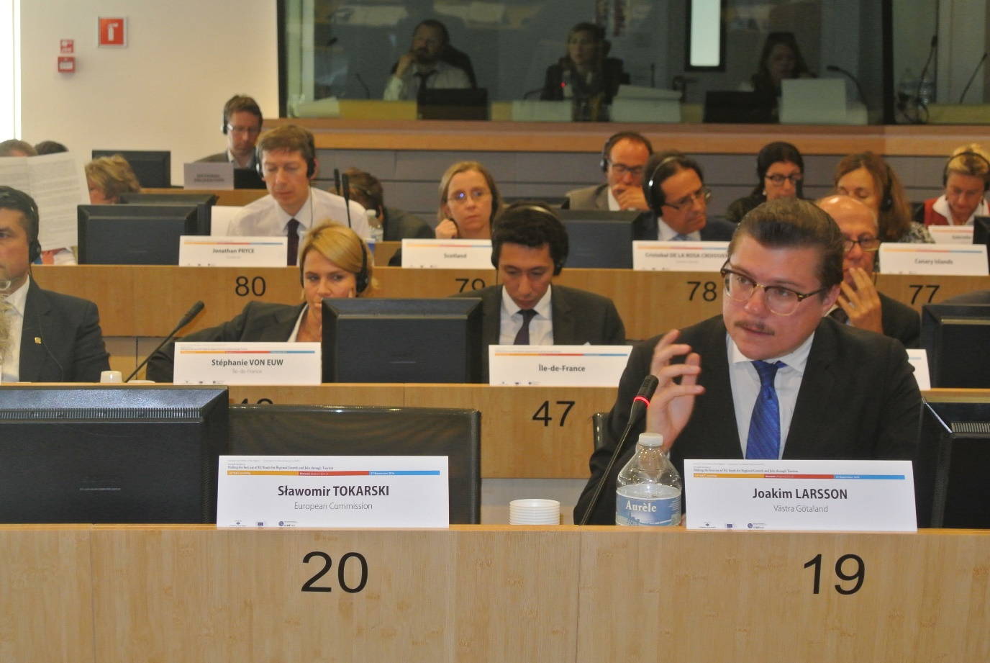
NECSTouR Services
5 Good Reasons to join us
Participate to influence the European Tourism Policy

Slide 30
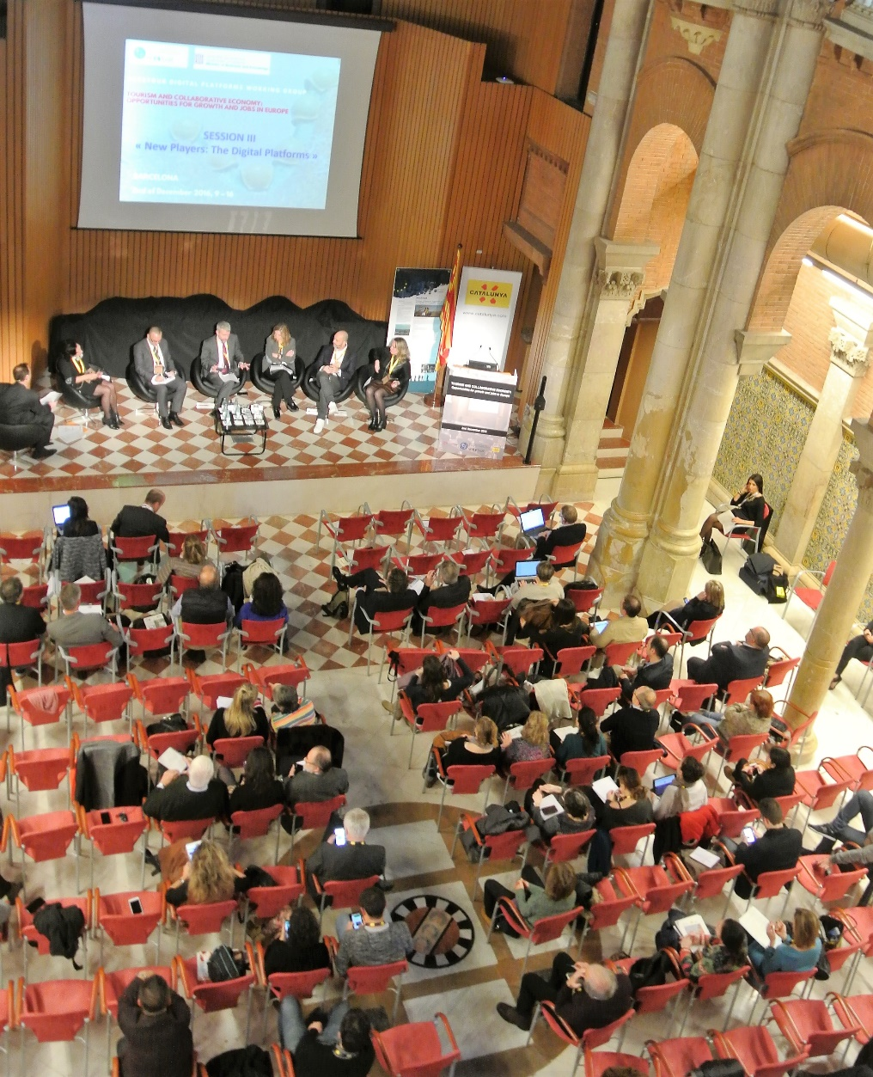
NECSTouR Services
5 Good Reasons to join us
2. Be part of an Open and Dynamic network of experts at regional, national, European and international level

Slide 31
NECSTouR Services
5 Good Reasons to join us
3. Have direct access to targeted knowledge, information and contacts of sustainable tourism

Slide 32
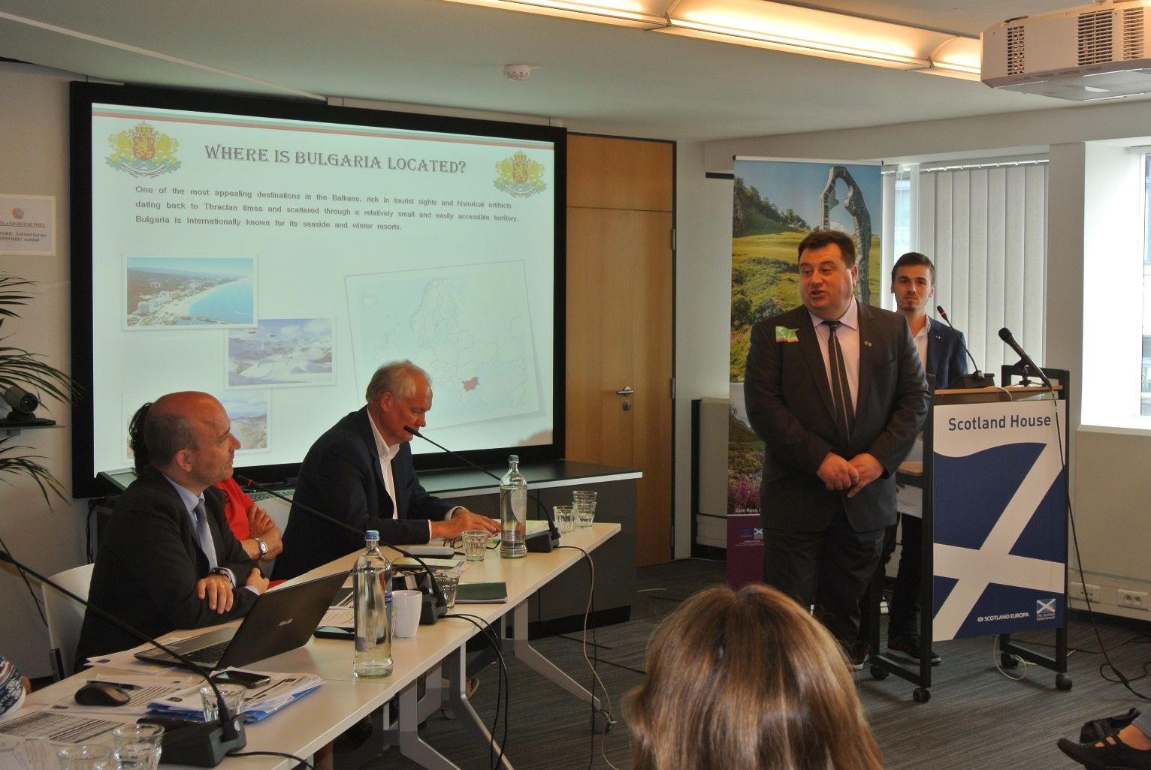
NECSTouR Services
5 Good Reasons to join us
4. Promote your Region/Organisation within the experts and towards the European/International Audience

Slide 33
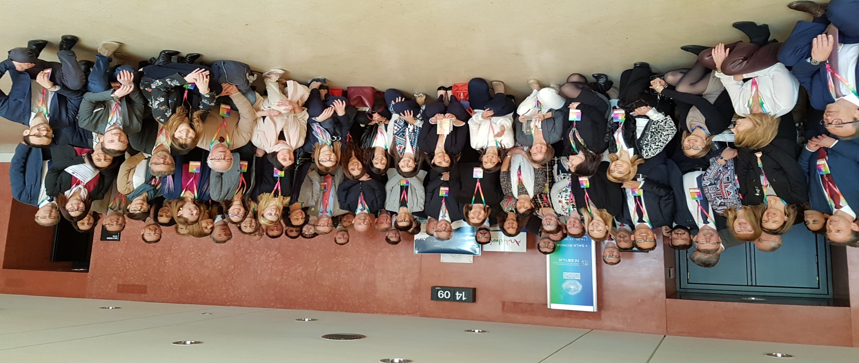
NECSTouR Services
5 Good Reasons to join us
5. Access to European Funds, developing project ideas and finding quality partners.

Slide 34
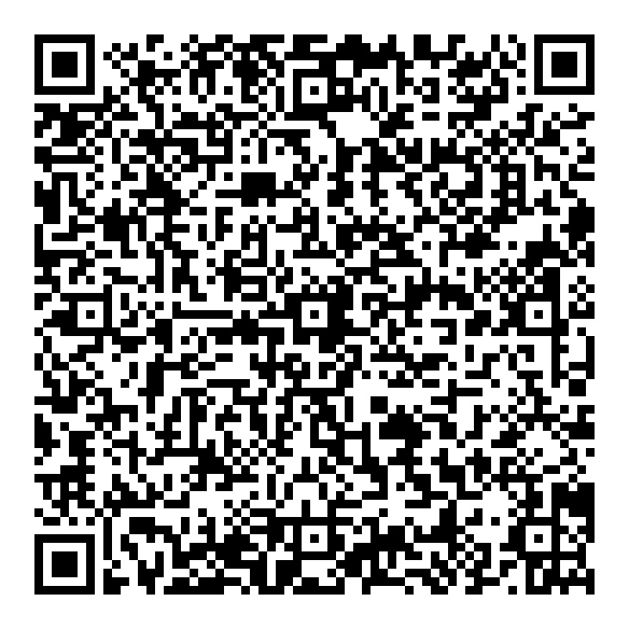
More info:
info@necstour.eu www.necstour.eu/join-us
www.necstour.eu

